Slide 1
Secure Data hiding in images using steganography
CAPSTONE PROJECT
Presented By: Shaik Noor Basha
Student Name : Shaik Noor Basha
College Name & Department : Madanapalle Institute of Technology and Science & MCA

Slide 2
OUTLINE
Problem Statement
Technology used
Wow factor
End users
Result
Conclusion
Git-hub Link
Future scope

Slide 3

Problem Statement
In today’s digital world, keeping sensitive information safe is a big challenge. People often share images online, but these images can be intercepted or misused by hackers. Steganography is a technique to hide secret data inside images without making them look suspicious. However, current methods may not be secure enough, and hidden data can be detected or extracted by attackers. The goal is to develop a secure steganography method that hides data in images effectively, making it nearly impossible for unauthorized users to detect or access the hidden information. The solution should ensure the image looks normal, the hidden data is safe, and only the intended recipient can retrieve it using a secret key or password.

Slide 4

Technology used
Libraries:
Python: Libraries like Pillow (for image processing), OpenCV (for advanced image manipulation), and stegano (for steganography) are widely used.
Matlab: Offers built-in tools for image processing and steganography.
Platforms:
Jupyter Notebook: For testing and visualizing the steganography process.
Web-based tools: Flask or Django can be used to create web apps for steganography.
Encryption:
Libraries like cryptography or pycrypto are used to encrypt data before hiding it in images for added security.

Slide 5

Wow factors
Invisible to the Eye: Data is hidden in images so well that no one can see it, making it super stealthy.
Double Security: Combines steganography (hiding data) with encryption (scrambling data) for extra protection.
Works with Any Image: Hides data in common image formats like JPEG, PNG, or BMP without ruining the picture.
High Capacity: Can hide large amounts of data without making the image look suspicious.
Anti-Hacking: Uses advanced techniques to prevent detection or extraction by hackers.
Real-World Use: Perfect for secure messaging, copyright protection, or confidential data sharing.
User-Friendly: Simple tools make it easy for anyone to hide or retrieve data.

Slide 6

End users
Individuals - People who want to hide personal messages or sensitive
information in images for privacy.
Business Professionals - Employees or companies needing to securely
share confidential data like contracts or reports.
Journalists - Reporters who want to protect their sources or sensitive information while sharing images.
Government Agencies - Organizations that need to send classified or secret information securely.
Military Personnel - Soldiers or officers who need to share strategic plans or coordinates without detection.
Law Enforcement - Police or investigators who want to hide evidence or communication in images.
Activists - People in risky areas who need to share information without being caught by authorities.
IT Professionals - Tech experts who use steganography to test security systems or protect data.
Artists or Designers - Creators who want to embed hidden messages or signatures in their digital artwork.
Students or Researchers - Learners studying steganography or using it for academic projects.

Slide 7
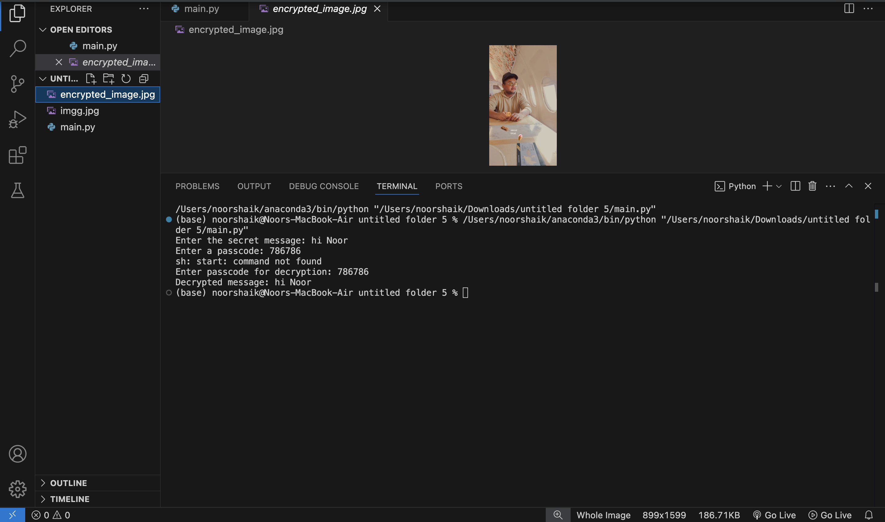

Results

Slide 8

Conclusion
In conclusion, the project "Secure Data Hiding in Images Using Steganography" successfully demonstrates a method to hide sensitive information within images, ensuring privacy and security. By embedding data into the pixel values of an image, the technique makes the hidden information invisible to the human eye and difficult for unauthorized users to detect. This approach is particularly useful for secure communication, as it allows data to be transmitted without drawing attention. The project highlights the importance of steganography in protecting confidential information, especially in an era where digital security is crucial. While the method is effective, it is essential to continue improving the technique to counter advanced detection tools and ensure robust security. Overall, this project provides a practical and efficient solution for secure data hiding, making it a valuable tool for safeguarding digital communication.

Slide 9
GitHub Link
GitHub Link : https://github.com/Nooor786/Secure-Data-Hiding-in-Images-using-Steganography

Slide 10

Future scope (optional)
Better Security: Future research can focus on making steganography even more secure by using advanced encryption methods, making it harder for hackers to detect hidden data.
AI Integration: Combining steganography with artificial intelligence (AI) can improve how data is hidden and retrieved, making the process faster and more efficient.
Real-Time Applications: Developing systems that can hide and extract data in real-time, like during video calls or live streaming, could be a major step forward.
Broader Use Cases: Steganography can be applied in new areas like healthcare (hiding patient data in medical images) or banking (securely transmitting financial information).
Improved Detection Tools: Creating better tools to detect hidden data in images can help improve the overall security of steganography, making it more reliable for sensitive communications.

Slide 11

THANK YOU

